Slide 1
Express Server with React Client
Mathew Kott
Rosalinda Gutierrez
Kal McClure
Latham Graham
Notes:
Team members Mathew Kott, Rosalinda Gutierrez, Kal McClure, and Latham Graham

Slide 2
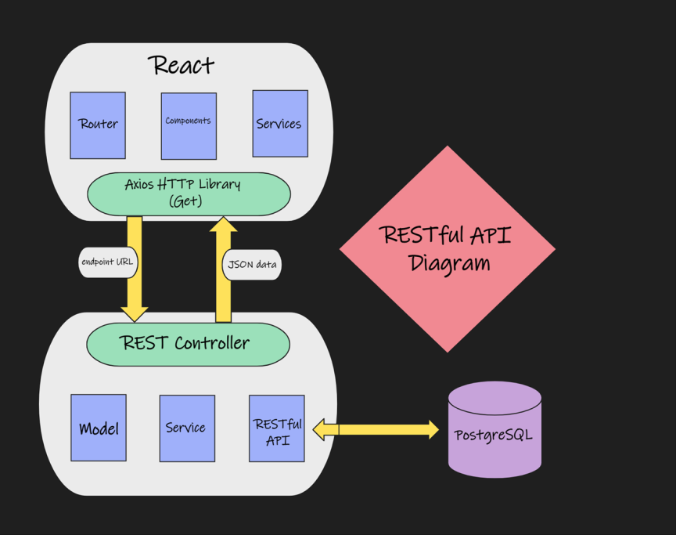
Project Overview:
A RESTful API:
JavaScript Execution
Node.js
Back End: Express
Front End: React
Notes:
A Restful Api was accomplish by using JS for function execution, implementing Node.JS, creating the server with Express, Front End Application was implemented using React

Slide 3
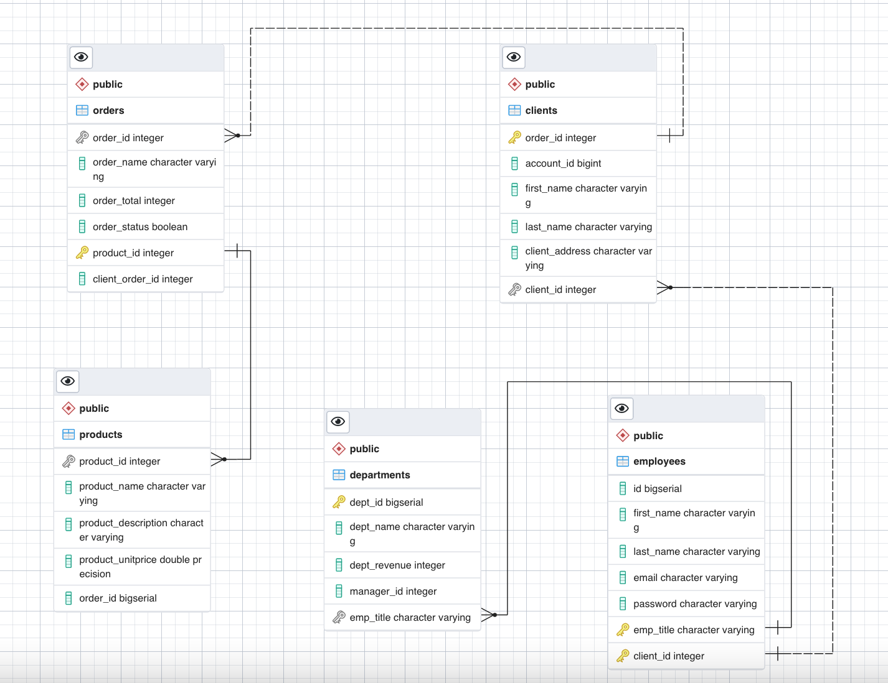
Diagram
Database: PostgreSQL

Slide 4
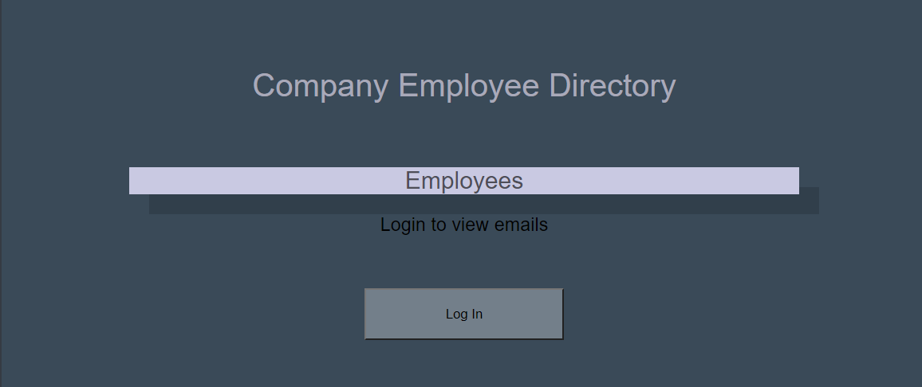
Functionality
Authorized Client Capabilities
The User Friendly App
Auth0 Security Protocol
Notes:
Clients of the API are able to log into the API and then provide data to authorized clients.
Usage of the project is for displaying employee names and emails for authorized users for a company in any easy to use, accessible app.
Authentication of users was implemented using Auth0 security protocol with the use of JSON Web tokens.

Slide 5
Thank You

